Slide 1
INTRODUCTION TO COMPUTING
Course Code: CCINCOM/L
Proofs
Joseph Marvin R. Imperial
Faculty
Department of Computer Science
College of Computing and Information Technologies (CCIT)
National University
Joseph Marvin R. Imperial
ALGORITHMS AND COMPLEXITY
NU College of Computing and Information Technologies
Course Code: ALGOCOM

Slide 2
Prove
The square of an odd number is also odd.
If a and b are consecutive integers, the sum of a + b must be an odd number.
If a and b are even, then ab is also an even number.
ALGORITHMS AND COMPLEXITY
Course Code: ALGOCOM

Slide 3

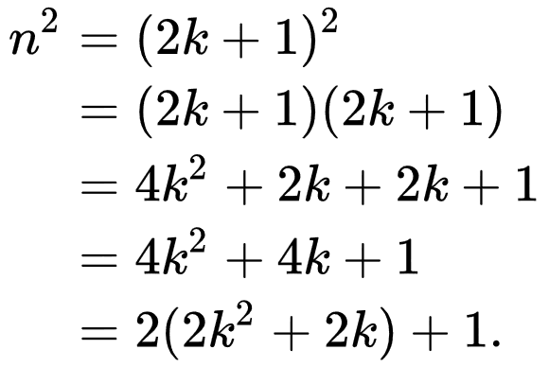
“The square of an odd number is also odd.”
By definition, if n is an odd integer, it can be expressed as
for some integer k. Thus
Since 2(k²+ 2k) is an integer, n² is also odd. ∎
ALGORITHMS AND COMPLEXITY
Course Code: ALGOCOM

Slide 4
Why do we need to prove things?
Being able to write down a valid proof may indicate that you have a thorough understanding of the problem.
A mathematician that tries to prove something may gain a great deal of understanding and knowledge, even if his/her efforts to prove that conjecture will end with failure.
Mathematics is about understanding the laws behind numbers, algebra and geometry. It is about finding new and non routine ways to look at these systems and to explain strange phenomena that we may encounter.
ALGORITHMS AND COMPLEXITY
Course Code: ALGOCOM

Slide 5
Why do we need to prove things?
There may other viable proofs to the same theorem/ problem each coming from a completely different approach and mathematical knowledge.
ALGORITHMS AND COMPLEXITY
Course Code: ALGOCOM

Slide 6
Proof/s
A proof is a sequence of logical statements, one implying another, which gives an explanation of why a given statement is true.
In math, and computer science, a proof has to be well thought out and tested before being accepted.
Opinions are not entertained. Only logical reasoning.
We try to prove things beyond any doubt at all.
ALGORITHMS AND COMPLEXITY
Course Code: ALGOCOM

Slide 7
Parts of a mathematical proof
Statements - sentences that are either true or false but not both.
For example:
6 is an even integer
4 is an odd integer
are statements.
We can use letters such as p and q to denote statements.
ALGORITHMS AND COMPLEXITY
Course Code: ALGOCOM

Slide 8
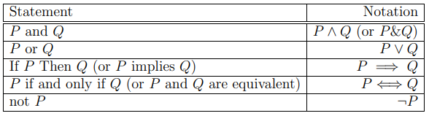
Parts of a mathematical proof
Statements - sentences that are either true or false but not both.
ALGORITHMS AND COMPLEXITY
Course Code: ALGOCOM

Slide 9
Parts of a mathematical proof
Logical operators
We can combine or modify numbers with operations such as ‘+’, ‘×’, etc.
Likewise, in logic, we have certain operations for combining or modifying statements; some of these operations are ‘and’, ‘or’, ‘not’, and ‘if. . . then’.
ALGORITHMS AND COMPLEXITY
Course Code: ALGOCOM

Slide 10
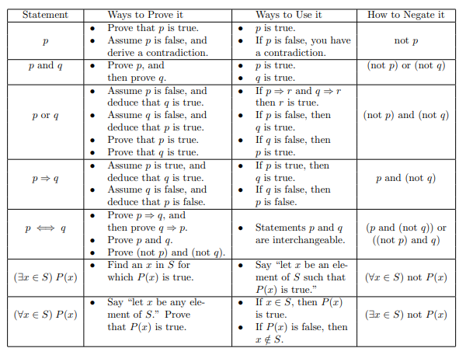
ALGORITHMS AND COMPLEXITY
Course Code: ALGOCOM

Slide 11

Direct Proof
A direct proof does not require knowledge of any special techniques.
The argument is constructed using a series of simple statements, where each one should follow directly from the previous one.
Propositions of the form
are shown to be valid by starting at A by writing down what the hypothesis means and consequently approaching B using correct implications.
ALGORITHMS AND COMPLEXITY
Course Code: ALGOCOM

Slide 12
“The square of an odd number is also odd.”
By definition, if n is an odd integer, it can be expressed as
for some integer k. Thus
Since 2(k²+ 2k) is an integer, n² is also odd. ∎
ALGORITHMS AND COMPLEXITY
Course Code: ALGOCOM

Slide 13
Try using Direct Proof
1. If n and m are both even, then n + m is even,
2. If n and m are both odd, then n + m is even,
3. If one of n and m is even and the other is odd, then n + m is odd.
ALGORITHMS AND COMPLEXITY
Course Code: ALGOCOM

Slide 14
Proof of Induction
Let P(n) be a statement about the positive integer n.
For example:
P(n) = “If n is even, then n² is divisible by 4.”
Suppose we want to show that P(n) is true for every positive integer n. How can we do this?
ALGORITHMS AND COMPLEXITY
Course Code: ALGOCOM

Slide 15
Proof of Induction
We just have to do two things. Prove that:
1. P(1) is true.
2. For every n ∈ Z⁺, assume that P(n) is true, then prove that P(n + 1) is true based on P(n).
Why is this sufficient? Well, suppose we have proved 1 and 2 above. Then we know that P(1) is true. Since P(1) ⇒ P(2), we know that P(2) is true. Since P(2) ⇒ P(3), we know that P(3) is true. Since P(3) ⇒ P(4), we know that P(4) is true and so on…similar to a domino effect.
ALGORITHMS AND COMPLEXITY
Course Code: ALGOCOM

